Slide 1

Chapter 28
ICMPv6
Copyright © The McGraw-Hill Companies, Inc. Permission required for reproduction or display.

Slide 2
OBJECTIVES:
To introduce ICMPv6 and compare and contrast it with ICMPv4.
To discuss error messages in ICMPv6 and compare and contrast them with the error messages in ICMPv4.
To discuss informational messages in ICMPv6 and compare and contrast them with the informational messages in ICMPv4.
To discuss neighbor discovery messages as part of the ND and IND protocol.
To discuss group membership messages as part of the MLDv2 protocol

Slide 3
Chapter
Outline
28.1 Introduction
28.2 Error Messages
28.3 Informational Messages
28.4 Neighboring Discovery
Messages
28.5 Group Membership
Messages

Slide 4
28-1 INTRODUCTION
Another protocol that has been modified in version 6 of the TCP/IP protocol suite is ICMP. This new version, Internet Control Message Protocol version 6 ( ICMPv6 ), follows the same strategy and purposes of version 4. ICMPv6, however, is more complicated than ICMPv4: some protocols that were independent in version 4 are now part of ICMPv6 and some new messages have been added to make it more useful.

Slide 5
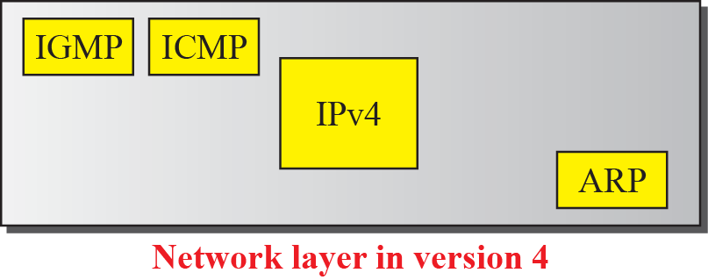
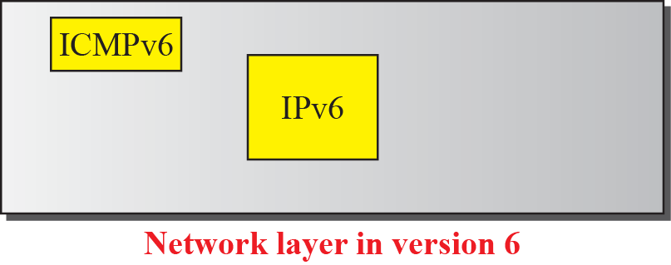
Figure 28.1 Comparison of network layers in version 4 and version 6

Slide 6
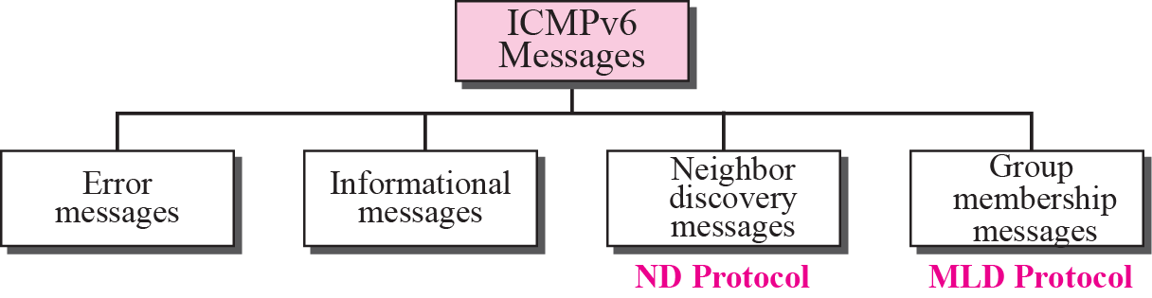
Figure 28.2 Taxonomy of ICMPv6 messages

Slide 7
28-2 ERROR MESSAGES
As we saw in our discussion of version 4, one of the main responsibilities of ICMP is to report errors. Four types of errors are handled: destination unreachable, packet too big, time exceeded, and parameter problems (see Figure 28.3).

Slide 8
Topics Discussed in the Section
Destination-Unreachable Message
Packet-Too-Big Message
Time-Exceeded Message
Parameter-Problem Message

Slide 9
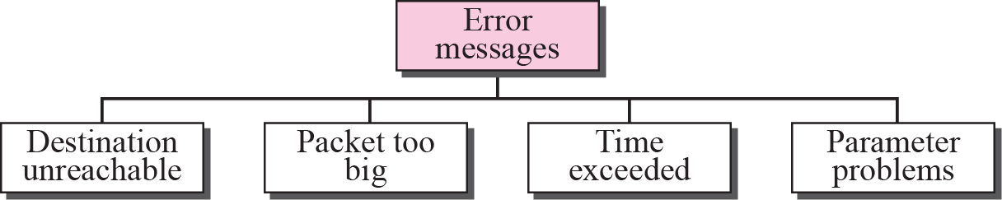
Figure 28.3 Error-reporting messages

Slide 10
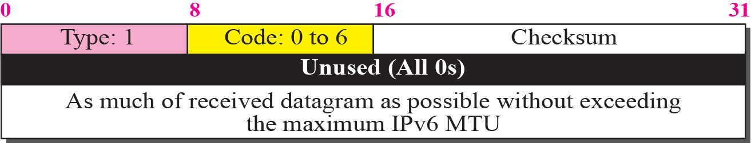
Figure 28.4 Destination unreachable message

Slide 11
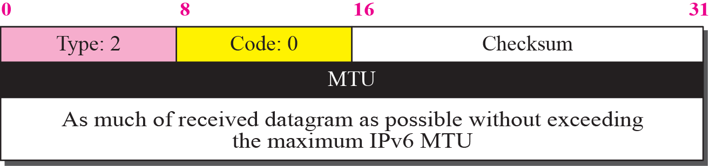
Figure 28.5 Packet-too-bit message

Slide 12
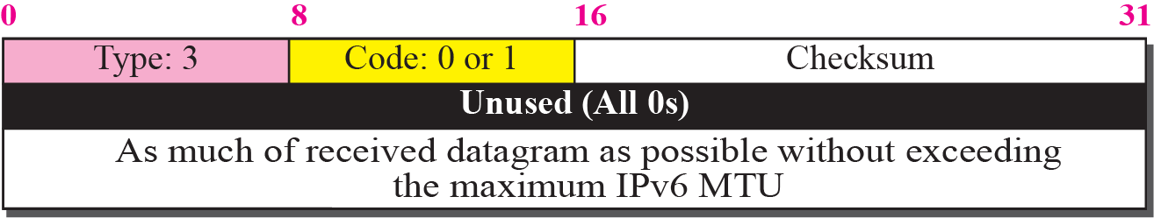
Figure 28.6 Time-exceeded message

Slide 13
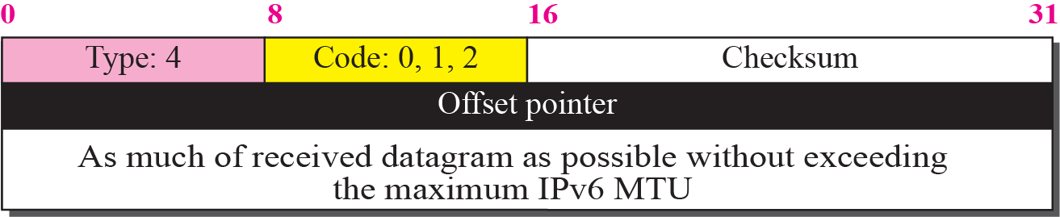
Figure 28.7 Parameter-problem message

Slide 14
28-3 INFORMATIONAL MESSAGES
Two of the ICMPv6 messages can be categorized as informational messages: echo request and echo reply messages. As discussed in Chapter 9, the echo request and echo response messages are designed to check if two devices in the Internet can communicate with each other. A host or router can send an echo request message to another host; the receiving computer or router can reply using the echo response message.

Slide 15
Topics Discussed in the Section
Echo-Request Message
Echo-Reply Message

Slide 16
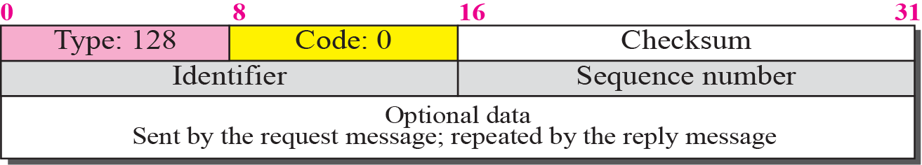
Figure 28.8 Echo-request message

Slide 17
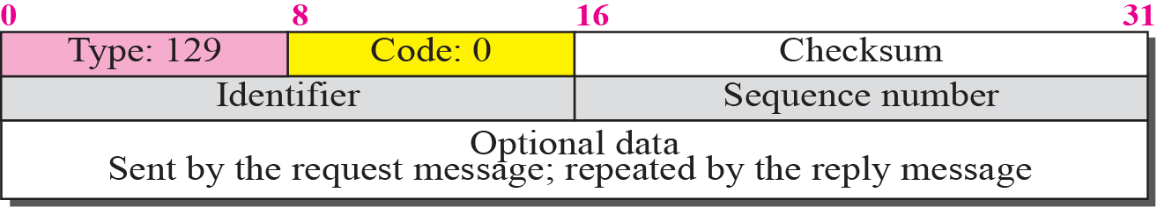
Figure 28.9 Echo-reply message

Slide 18
28-4 NEIGHBOR-DISCOVERY
MESSAGES
Several messages in the ICMPv6 have been redefined in ICMPv6 to handle the issue of neighbor discovery. Some new messages have also been added to provide extension. The most important issue is the definition of two new protocols that clearly define the functionality of these group messages: the Neighbor-Discovery (ND) protocol and the Inverse-Neighbor-Discovery (IND) protocol. These two protocols are used by nodes (hosts or routers) on the same link (network).

Slide 19
Topics Discussed in the Section
Router-Solicitation Message
Router-Advertisement Message
Neighbor-Solicitation Message
Neighbor-Advertisement Message
Redirection Message
Inverse-Neighbor-Solicitation Message
Inverse-Neighbor-Advertisement Message

Slide 20
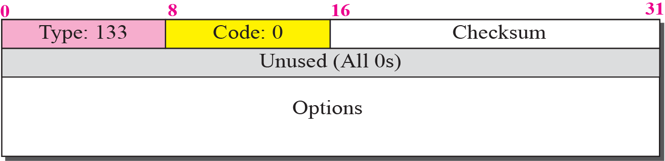
Figure 28.10 Router-solicitation message

Slide 21
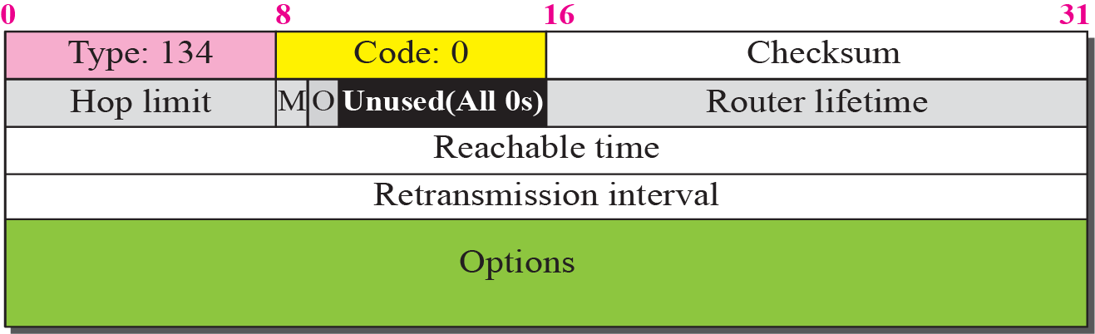
Figure 28.11 Router-advertisement message

Slide 22
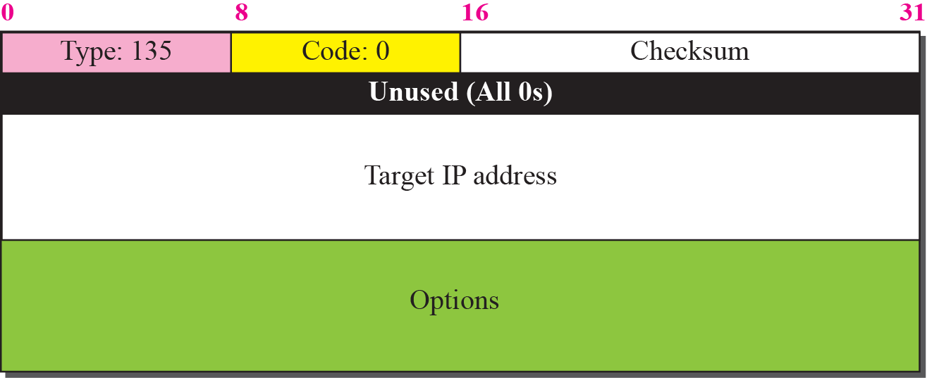
Figure 28.12 Neighbor-solicitation message

Slide 23
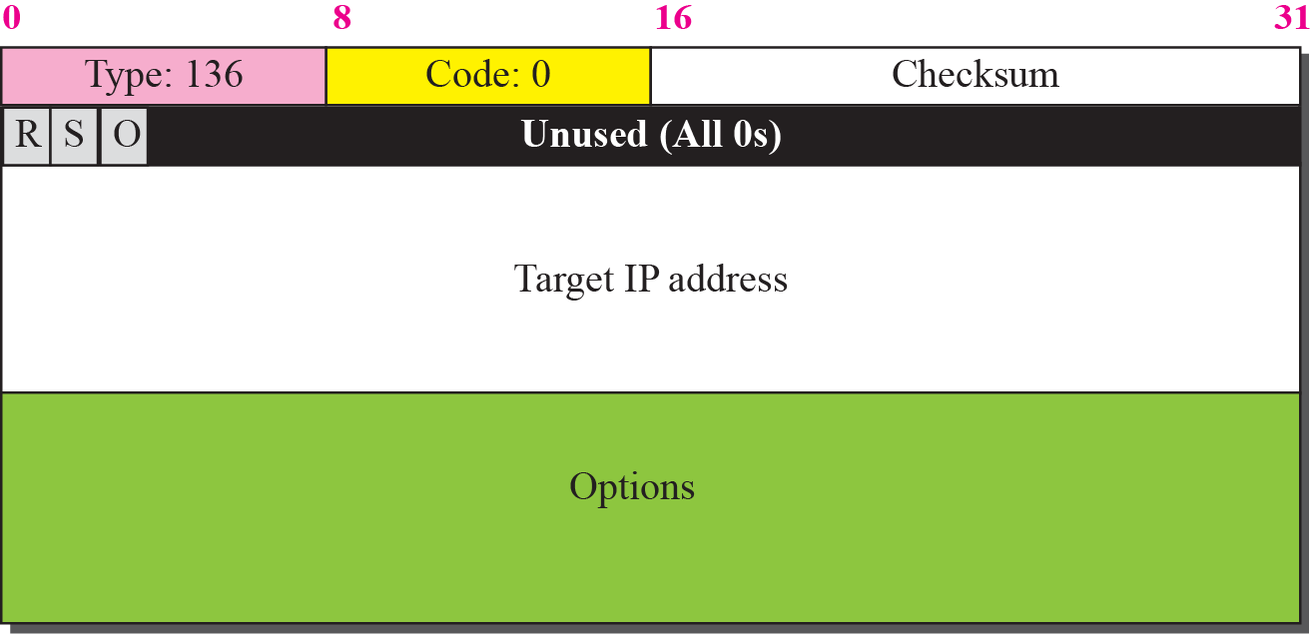
Figure 28.13 Neighbor advertisement message

Slide 24
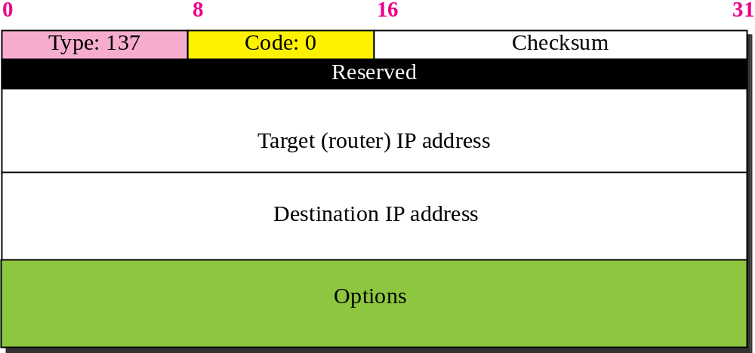
Figure 28.14 Redirection message

Slide 25
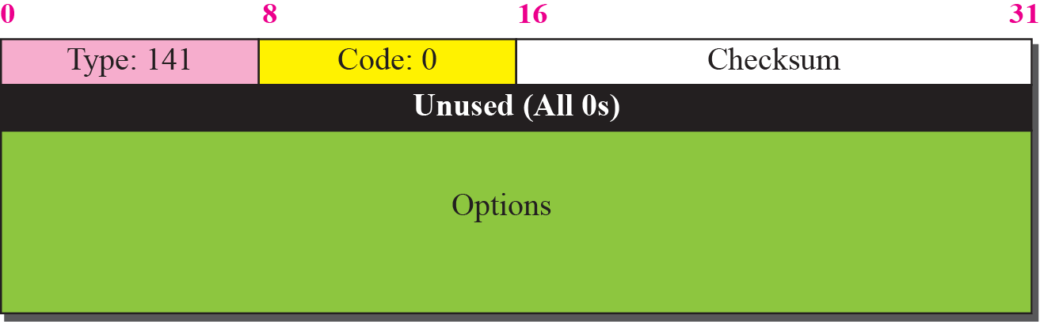
Figure 28.15 Inverse-neighbor-solicitation message

Slide 26
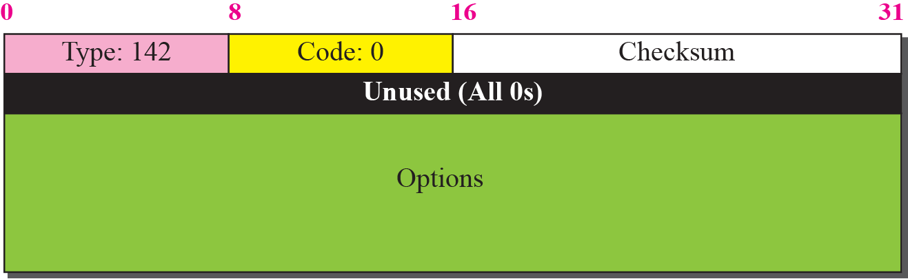
Figure 28.16 Inverse-neighbor-advertisement message

Slide 27
28-5 GROUP MEMBERSHIP MESSAGES
The management of multicast delivery handling in IPv4 is given to the IGMPv3 protocol. In IPv6, this responsibility is given to the Multicast Listener Delivery protocol. MLDv1 is the counterpart to IGMPv2; MLDv2 is the counterpart to IGMPv3. The material discussed in this section is taken from RFC 3810. The idea is the same as in IGMPv3, but the sizes and formats of the messages have been changed to fit the larger multicast address size in IPv6.

Slide 28
Topics Discussed in the Section
Membership-Query Message
Membership-Report Message
Functionality

Slide 29
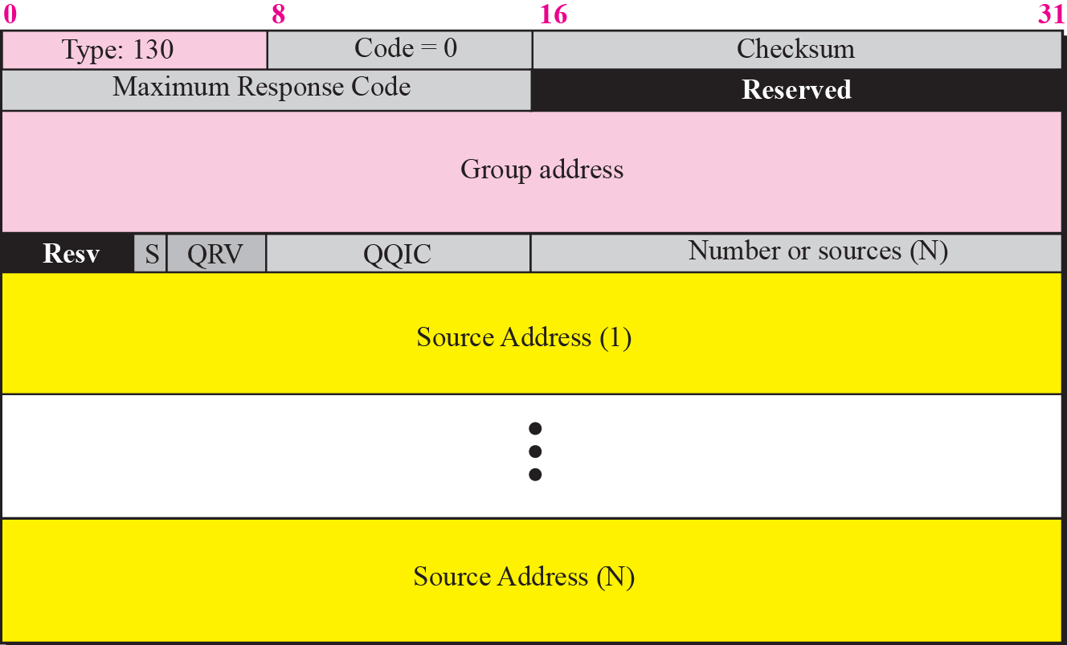
Figure 28.17 Membership query message format

Slide 30
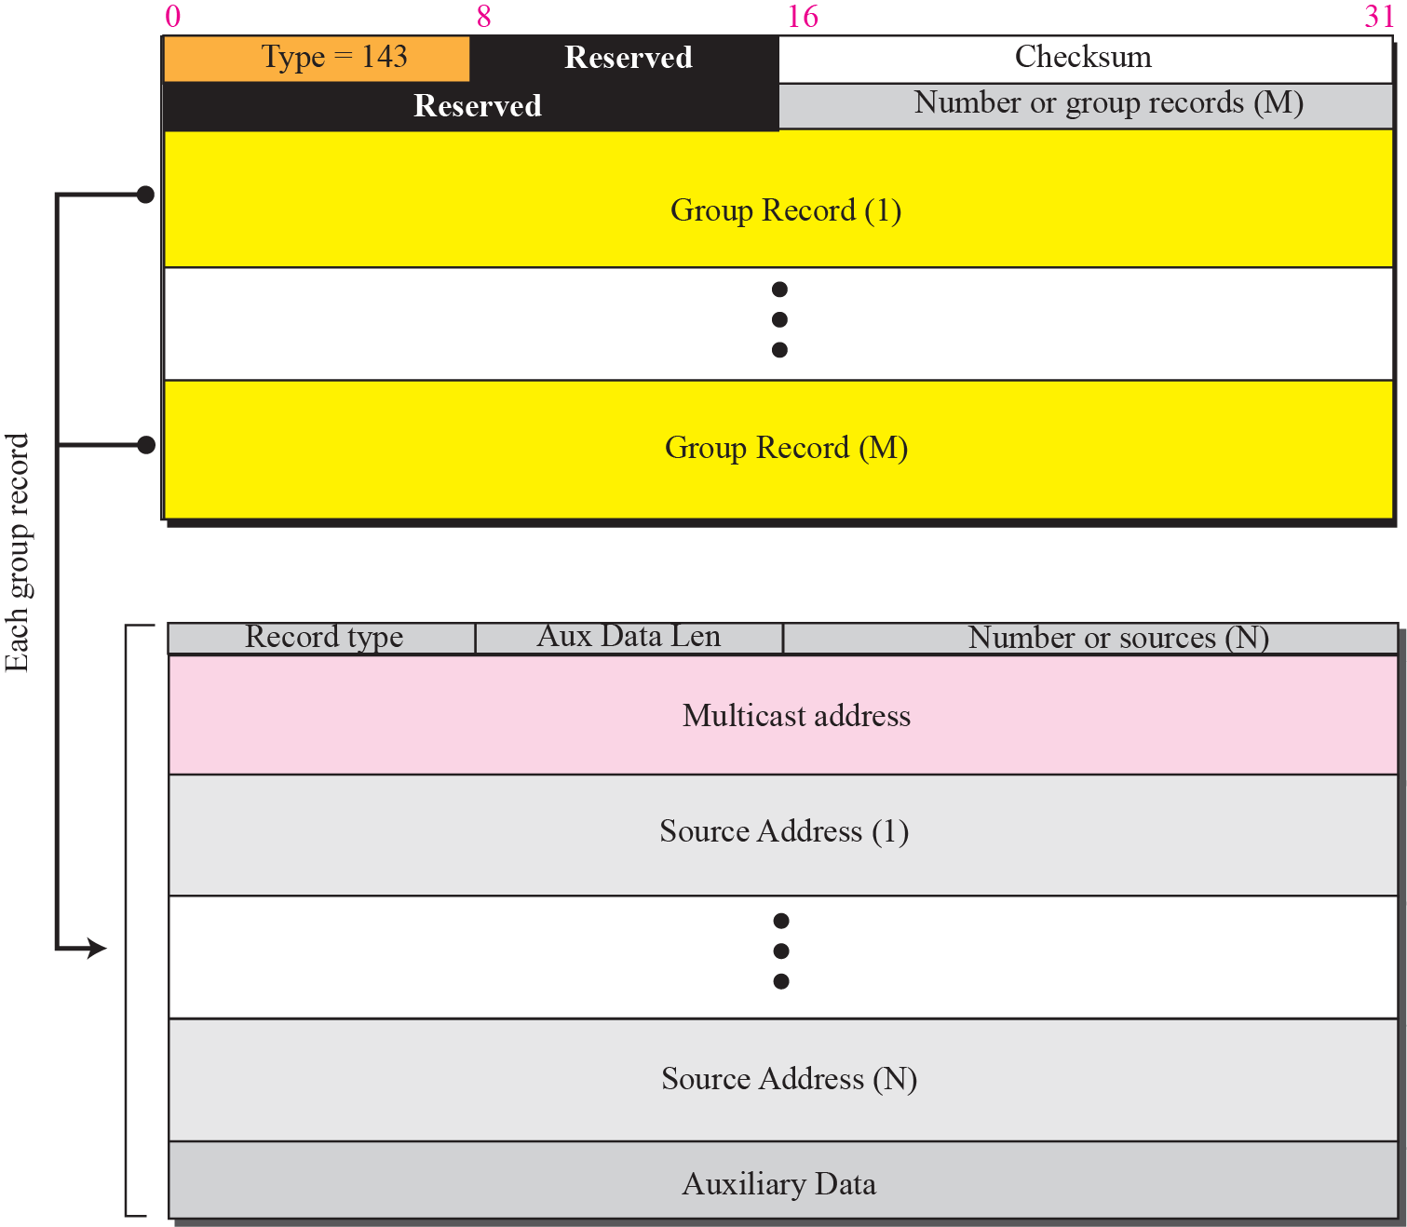
Figure 28.18 Membership-report message format

Slide 31
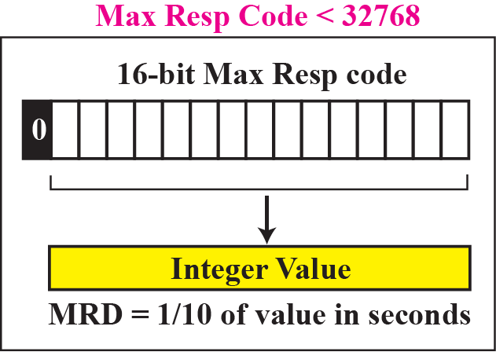
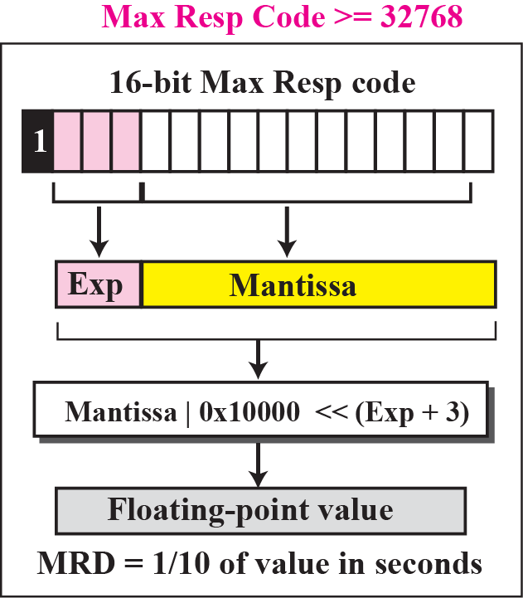
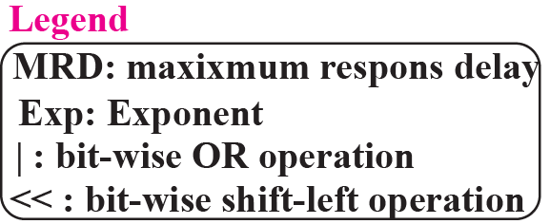
Figure 28.19 Calculation of maximum response time

Slide 32
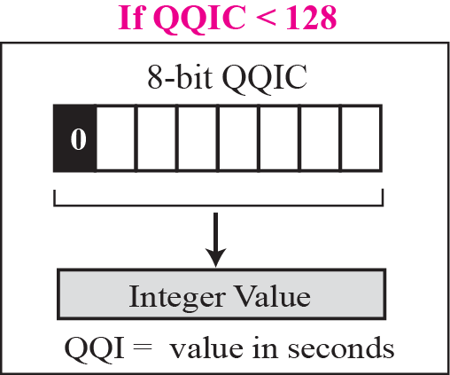
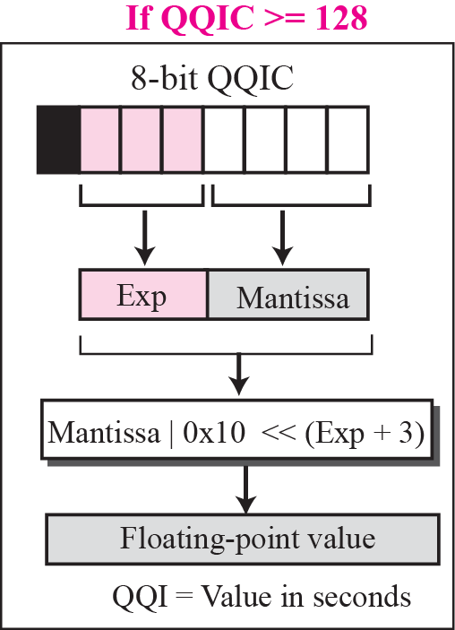
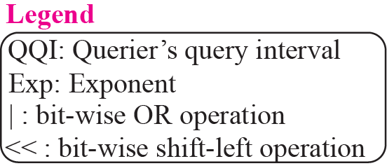
Figure 28.20 Calculation of query interval

